Slide 1
How to Keep Warm
Kerosene and Other Options
Notes:
We have covered almost every post-quake need except for how to keep warm. This presentation attempts to fill that gap.
As usual, the specific items and suppliers are intended for reference only, to get you started. There is some reading material cited on the final slide of you are interested in learning more.

Slide 2
Where to Hole Up
Ideally somewhere in covered structure (after enclosing broken windows and structural damage)
Able to be semi-sealed off to preserve heat (but still allow for some ventilation and in/out traffic)
Large enough to be multi-purpose (you are going to be there a while)
Small enough to make heating economical (fuel take lots of room to stockpile)
Notes:
The problem of keeping warm has to start with the decision of where you will be settling in after the quake. Ideally a large enough portion of your home will survive for that purpose. It may need some patching, of course. So have heavy duty plastic rolls, duct tape, even premade wooden panels for window frames, available to batten down the hatches.
Your living space should be able to be sheeted off to preserve whatever heat you generate. But you will need to make provision for entering and exiting, as well as for ventilation (odors as well as fumes from a heater).
Once you have chosen your space, measure it, because that will determine how much heating capacity you will need. The space may also dictate what type of heater (directional vs 360-degree) you purchase.

Slide 3
Optional Heat Sources
Lots of wood available; so for those with a wood-burning stove or a (surviving) fireplace this is a real option
Propane and Kerosene are most attractive options, and can meet multiple needs: heating, cooking, lighting.
Radiant and convection type heaters available; 10K - 25K BTU output.
Stoves available with various outputs and burner sizes.
Kerosene lamps available, with wicks or pressurized.
Have battery-powered CO detector and fire extinguisher available.
Notes:
Many homes have wood-burning fireplaces (assuming it survives the quake), or a wood burning stove. For them, wood is a great alternative.
But millions of people around the world rely on kerosene or propane for heating and cooking; and so, I expect, will most of us after a quake.
Radiant heaters heat things up line-of-sight. Solid objects between you and the heater will block your heat. Convection heaters heat the air which must then circulate.
Both kerosene and propane have heaters and stoves available; kerosene lanterns are also available. So one fuel can serve many purposes, which is important for stockpiling purposes.
If the CO monitors in your home are plug-in powered, you will need a battery powered device as a backup for the ventilation you are providing. Also have a fire extinguisher available: never use water to put out a kerosene fire.

Slide 4
Kerosene vs Propane
Both are safe to store and safe to use indoors, propane is odorless. Some ventilation required for either.
Propane cylinders take more room to store: tanks cost ~$50
Kerosene 2x-4x more expensive (1-K costs $10-$12/gallon)
Kerosene has higher heat capacity
Kerosene heaters require maintenance (model-specific wicks and fuel quality)
Notes:
These are some consideration whether to go kerosene or propane for your heating needs. The odor issue might be irrelevant: after a few months with no showers and using bucket toilets, kerosene might be a welcome background odor ;-)
Ventilation, to replenish oxygen that the heater is consuming and to reduce risk of CO buildup, needs to be provided. The link to the U of Missouri webpage on SAFETY provided at the end of the slide set specifies 1 sq inch of ventilation space per 1,000 BTU.
Propane cylinders are VERY bulky; typical outdoor grill 20# tanks hold 4.7 gallons propane. It is 2-4x cheaper than kerosene, but you can store a LOT more kerosene in a given space compared to propane. Larger propane tanks designed for whole home use would be great—but think ahead! Costs may be high, and Permits may be required.
Kerosene also has roughly 50% more heating capacity compared to propane. But kerosene heaters require wicks which require maintenance.

Slide 5
Kerosene
aka Jet Fuel, Paraffin, Lamp Oil. A petroleum distillate. A mixture of various hydrocarbons. Widely used worldwide in jets, motors, heaters, stoves.
Two Grades: 1-K (preferred) and 2-K (based on % sulfur), with various contaminants in cheaper grades; may also be tinted on purpose.
Energy Content (BTU/gallon): Kerosene ~135K; Gasoline ~114K; Propane: ~92K.
Availability: 1 - 5 Gallon plastic jugs or metal cans, 50 Gallon drums. Available at hardware stores and service stations. Usually stored in blue containers.
Quality determines odors, burning efficiency, wick life (water is especially damaging).
Notes:
Here’s some information regarding kerosene. The main thing to take note of is that there are two grades of kerosene, 1-K and 2-K. Only 1-K is acceptable for indoor heater use, based on odor and wick life. But even 1-K, if purchased from a filling station, can be contaminated or may have added coloring agent. As painful as it is, its best to buy the best 1-K you can find (typically $10-$12/gal), or pay even more for kerosene alternatives ($13/gal).
But don’t forget the one-time cost of the propane cylinder ($40-$50 on Amazon). Based on ~$3/gal propane, the cost per gallon for the 1st tankful is roughly $60, or almost $13/gal.
How much you stockpile will depend on the heater you buy and your best estimate how much you will run it. I am hoping 50 gal will get me through one heating season, by which time some other options might be becoming available. But that’s a big investment!

Slide 6
Propane
A pure hydrocarbon; a gas at room temperature, easily compressible for dispensing and storage.
Odorless, requires no wick or carburetor, used for home heating and cooking, and as car/bus/truck fuel.
Typically sold in 20 pound steel cylinders (4.7 gallon propane); 1-2 gallon tanks available; much larger tanks are used for whole home heating and cooking.
Available from service stations (refills), hardware store (exchanges), or home delivery for large tanks.
Notes:
Propane has a lot to be said for it. It is odorless; and requires no wicks and maintenance. It’s primary drawback is storage. More of it must be stored compared to kerosene based on BTU/gallon); and it must be stored in steel cylinders, typically 20#, each containing 4.7 gallons of propane.
Consider a 50-gallon (kerosene) storage example.
You will need 1.5 times as much propane as kerosene, so a 50-gal kerosene stockpile would expand to 75 gallons of propane. The kerosene could be stored in ten 5-gallon (stackable) cans. 75 gallons of propane would require storage of sixteen 20-pound (non-stackable) cylinders.

Slide 7
Summary Pros and Cons
KEROSENE
+ Produces more BTU/gallon
+ Allows for compact storage
- Costs more per gallon
- Requires wicks and maintenance
- Produces some odor
- Can pick up water if open
PROPANE
+ Produces no odors
+ Requires no wicks or maintenance
+ Unsusceptible to contamination
+ Costs less per gallon (refills)
- Requires expensive cylinders (initially)
- Produces fewer BTU/gallon
- Requires more storage space
Notes:
Some key differences between kerosene and propane are summarized in this slide. Chief among them in favor of kerosene are its more compact storage space and its higher BTU/gallon. In favor of propane are its odor-free, simple operation and its immunity against contamination. Propane units are also simpler to maintain, having no wick.
The price differential between kerosene and propane needs to take into consideration both the cost of the fuel and the container. Kerosene costs more per gallon for every purchase, and include the cost containers. Propane itself costs less per gallon, but there is a high initial cost per cylinder. Taking that into consideration, propane is roughly the same or slightly more per gallon initially, but much cheaper thereafter.

Slide 8
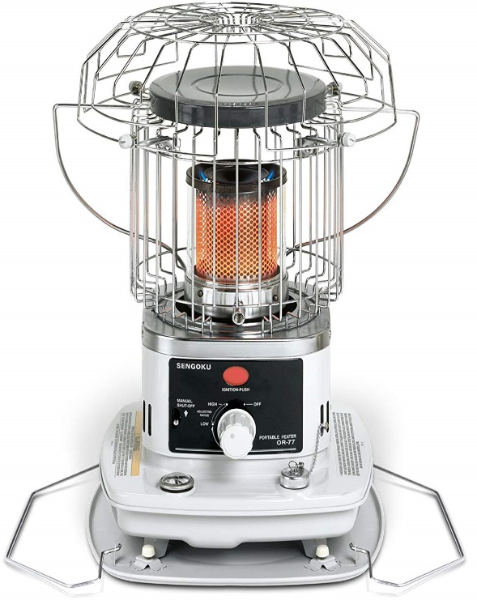
Kerosene Heaters
(Approximate size & cost per Amazon)
Radiant 10K BTU Radiant 10K BTU Convection 24K BTU
20x12x19 15x15x24 19x19x27
Directional 360º 360º
$100
$135
$150
Notes:
Here are three examples of different types of kerosene heaters. Some are made to be placed next to a wall; others need to be centrally located. Radiant heat is line of sight, convection relies on air circulation. Kerosene heaters usually have no adjustment: they are designed to run “full power” to preserve wick life. Some have removable fuel tanks for convenience in refilling outside the living area.
Typical heat outputs tend to be either 10K or 20-25K; and they claim respectively to heat 400 and 900 sq ft rooms.
Replacement wicks are specific to each model; high quality wicks run $10-$20.
Pictured products are:
Sengoku KeroHeat 10,000-BTU Indoor/Outdoor Portable Radiant Kerosene Heater, CTN-110
Sengoku HeatMate 10,000-BTU Portable Indoor/Outdoor Omni-Radiant Kerosene Heater, OR-77
Dura Heat DH2304S 23,800 BTU Indoor Kerosene Heater

Slide 9
Typical Wick (heater specific)
Notes:
This is a close up of a wick for a typical kerosene heater. You can see the cotton lower region that comes into contact with the fuel, and wick is up to the top, where it evaporates. It is the kerosene vapors that burn. But if the wick gets contaminated with water it cannot pull the fuel to the top; and suboptimal burning forms tar and carbon residue on the wick, further diminishing its efficiency. Some may be able to be burned off, or brushed off. But in the extreme, the wick has to be replaced.
Note that heaters and stoves require specific wicks; there is no one-size-fits-all generic wick.

Slide 10
Wicks
Essential for non-pressurized kerosene devices.
Made from cotton, with fiberglass top fringe (wear gloves!).
Cotton absorbs fuel and wicks it to the top.
Fuel at top evaporates and burns.
Properly maintained, wick does not burn or gum up.
Used improperly, wick builds up tar and carbon, requires cleaning, burn-off, or replacement (very tedious).
Notes:
The heart of kerosene heaters is the wick. This slide relates how those wicks work.
Replacing a wick is a total tear-down exercise, so you want to avoid that as long as possible. Wear gloves when handling wicks to protect from fibers.
Allowing sufficient (30-60 min) for a new wick to get totally filed with kerosene, and keeping contaminants (especially water) out of the fuel, are the best way to keep the wick clean.

Slide 11
Propane Heaters & Fuel
(Approximate size & cost per Amazon)
4-9K BTU Radiant 15-25K BTU Convection
7x13x15, $72 12x12x13, $72
Directional 360º
Notes:
There are many varieties (radiant and convection, directional and 360 degrees) of propane heaters as well; and they are frequently adjustable in heat output. Some can be run on 1 or 2 gallon cylinders, or by attachment to 20# cylinders
Pictured units are:
Mr. Heater F232000 MH9BX Buddy 4,000-9,000-BTU Indoor-Safe Portable Propane Radiant Heater by Mr. Heater
Dura Heat LPC25 15-25,000 BTU Propane (LP) Convection Heater by Dura Heat

Slide 12
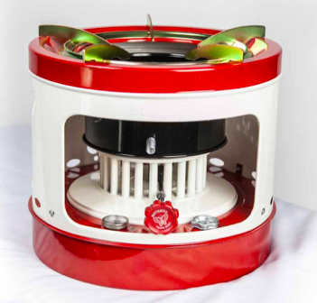
Kerosene Stoves
(approximate prices from St Paul Mercantile)
10-wick, 7K BTU 22 Wick, 14K BTU Pressurized
$45 $80 $75
Notes:
I have shown a few of the many kerosene stoves available. The vary in strength (how big a pot will they hold), and how many wicks they have (which determines BTU output). Multi-burner stoves are also available. There are also pressurized kerosene stoves, requiring no wick.
There are also numerous propane stoves, many designed to run on 1 or 2 gallon cylinders of propane, as well as being attachable to 20# cylinders.
Pictured products are:
10-wick 7000 BTU Kerosene Stove 2641
22-wick 14000 BTU Canning Stove 2698
Kerosene Brass Pressure Stove 2412

Slide 13
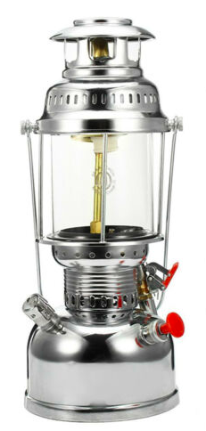
Kerosene Lanterns
Basic Fancy Pressurized
Notes:
Kerosene lanterns come in endless variations (and a huge price range), and are also available in pressurized versions (which produce a lot more light).
In contrast to stoves and heaters, wicks for lanterns are just long ribbons our ropes of woven cotton fabric or fiberglass.

Slide 14
Purchasing Kerosene
5-gallon ($49) 2.5 Gal ($28) 1 Gal alternative ($12)
Avoid long-term storage in plastic jugs
Beware of kerosene from filling stations
Notes:
These are common sizes of kerosene sold in hardware and other stores. Kerosene from filling stations will be cheaper, but may contain particulates, water, or other contaminants that affect heater performance.
Empty plastic or steel containers ($20-$30) to dispense kerosene into, are typically blue to distinguish them from gasoline (red) and diesel (yellow).
Adding a water scavenger protects against water (condensation) contaminating the fuel and destroying the wick.
Sealed steel containers seem to offer the best chance of stability over long term storage. Add water scavenger after opening.
Store kerosene protected from the elements, away from ignition source, and (for cans) on a surface where water does not accumulate. Periodically inspect the containers visually for signs of deterioration (e.g., rust) or any leakage.

Slide 15
Refillable Propane Cylinders
1# (~1 qt) $15 20# (4.7 gal), $49 30# (7 gal) $48
12x12x18 12x12x24
Notes:
Consumer propane cylinders come in a variety of sizes up to 100 pounds. Three sizes are shown here. Prices vary widely.
http://www.propane101.com/consumerpropanecylinders.htm
Large tanks can be refilled at many service stations; and typical “gas grill” 20# tanks can be exchanged at hardware or grocery stores. One gallon tanks can be refilled from larger cylinders using adapter kits.
Care should be taken to properly store tanks vertically, away from high traffic areas, well ventilated, away from any source of ignition, and on a surface where water does not accumulate. Tanks can be visually inspected periodically for any indications of deterioration (e.g., rust), and can be weighed to detect significant loss of gas.
http://www.propane101.com/propanecylinderstorage.htm
In order to be refilled, federal law requires propane tank re-certification after 10 years from the original manufacture date. The manufacture date can be found stamped onto its collar, in a month-year format — for instance, 06-17 for June 2017. A tank past its service life will not be refilled by a service station and must be exchanged.
https://www.lpgasmagazine.com/dot-cylinder-requalification-rule-to-impact-propane-marketers/
You can estimate the propane in a cylinder by subtracting its total weight from its tare weight. The tank tare weight is stamped onto its collar, and is prefaced by the letters TW, i.e. TW18 for an 18 lb. tank. A fully filled 20# (equal to 4.7 gallons of propane) cylinder should weigh approximately 20# more than its tare weight. Be aware that "exchange" types of tanks may not be filled to capacity:
https://www.youtube.com/watch?v=YwYgD9SKPLs

Slide 16
Additional Considerations
Have battery-powered CO detector, fire extinguisher and spare wicks on hand.
Do not leave operating devices unattended.
Use filter or additive to scavenge water: the longer the storage, the more likely water is to get into the fuel.
Mr. Funnel ($15, The Wick Shop) Scavenger ($8, Amazon)
Notes:
Just a few final notes. Remember to have a battery-battery-poured CO monitor available. Be sure to have spare wicks on hand. A fire extinguisher should also be available—never use water on a kerosene fire!
A water scavenger to add to an open container of kerosene is a good way to protect wick life.
Pouring the kerosene through a final filter gives added protection against any solid as well as any water getting into the heater tank itself.

Slide 17
Additional Resources
Amazon has full selection of heaters, stoves, lanterns for both kerosene and propane
For information regarding SAFETY in using Kerosene heaters: https://extension2.missouri.edu/g1999
For a discussion of RADIANT vs CONVECTION heating: https://www.newair.com/blogs/learn/convection-heating-vs-radiant-heating
Information (LOTS) on kerosene heaters in general, and WICKS in particular: http://www.milesstair.com
Information on kerosene stoves and STORING kerosene: https://www.kerosenestoves.net/index.html
Information on KEROSENE COOKSTOVES is available at: https://stpaulmercantile.com/kerosene-cook-stoves-and-oven?zenid=t9bgivrqi99r2h8jcm87ttkuu6
Suppliers for 5-gallon 1-K Kerosene: Ace, Walmart, Home Depot, Lowes—but be sure to call the store or check online for availability; not all stores keep these in stock

